Slide 1
5-VIRTUAL MACHINES PROVISIONING AND MIGRATION SERVICES
Cloud Computing
Principles and Paradigms

Slide 2
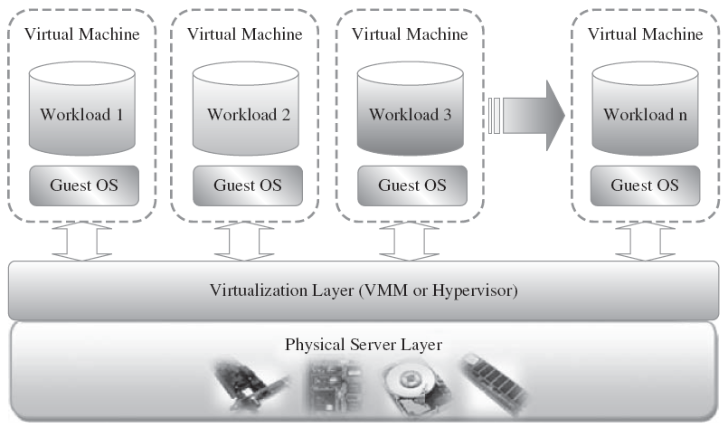
Virtualization Overview
Notes:
Virtualization can be defined as the abstraction of the four computing resources (storage, processing power, memory, and network or I/O).
It is conceptually similar to emulation, where a system pretends to be another system, whereas virtualization is a system pretending to be two or more of the same system.
the virtualization layer will partition the physical resource of the underlying physical server into multiple virtual machines with different workloads.
These machines can be scaled up and down on demand with a high level of resources’ abstraction.
Virtualization enables high, reliable, and agile deployment mechanisms and management of services, providing on-demand cloning and live migration services which improve reliability.

Slide 3
Public Infrastructure Cloud
Examples
Amazon Elastic Compute Cloud (EC2)
GoGrid, Joyent, Accelerator, Rackspace
AppNexus, FlexiScale, Manjrasoft Aneka
EC2
leveraged via
Web services (SOAP or REST)
Web-based AWS (Amazon Web Service) management console
EC2 command line tools
AMI (Amazon Machine Images)
Different instance size
Resource need (small, large, and extra large)
High cpu (medium and extra large high CPU instances)
High-memory (extra large, double extra large, quadruple extra large)
Notes:
resources are dynamically provisioned via publicly accessible Web applications/Web services (SOAP or REST ful interfaces)
---------------------------------------------------------------------------------------------------
These services can be leveraged via Web services (SOAP or REST), a Web-based AWS (Amazon Web Service) management console, or the EC2 command line tools. The Amazon service provides hundreds of pre-made AMIs (Amazon Machine Images) with a variety of operating systems (i.e., Linux, OpenSolaris, or Windows) and pre-loaded software.
Amazon offers different instance’s size according to (a) the resource’s needs (small, large, and extra large), (b) the high CPU’s needs it provides (medium and extra large high CPU instances), and (c) high-memory instances (extra large, double extra large, and quadruple extra large instance).

Slide 4
Private Infrastructure Cloud
Meet Security and Governance
Inside organization firewall
May within a cloud vendor’s data center
Characteristic
Allow service provisioning and compute capability for an organization’s users in a self-service manner
Automate and provide well-managed virtualized environments
Optimize computing resources, and servers’ utilization
Support specific workloads
Examples
Eucalyptus
OpenNebula
Hybrid Cloud
Notes:
A private cloud aims at providing public cloud functionality, but on private resources, while maintaining control over an organization’s data and resources to meet security and governance’s requirements in an organization.
It may also be a private space dedicated for your company within a cloud vendor’s data center designed to handle the organization’s workloads.
---------------------------------------------------------------------------
“hybrid cloud,” in which a combination of private/internal and external cloud resources exist together by enabling outsourcing of noncritical services and functions in public cloud and keeping the critical ones internal.

Slide 5
Provisioning

Slide 6
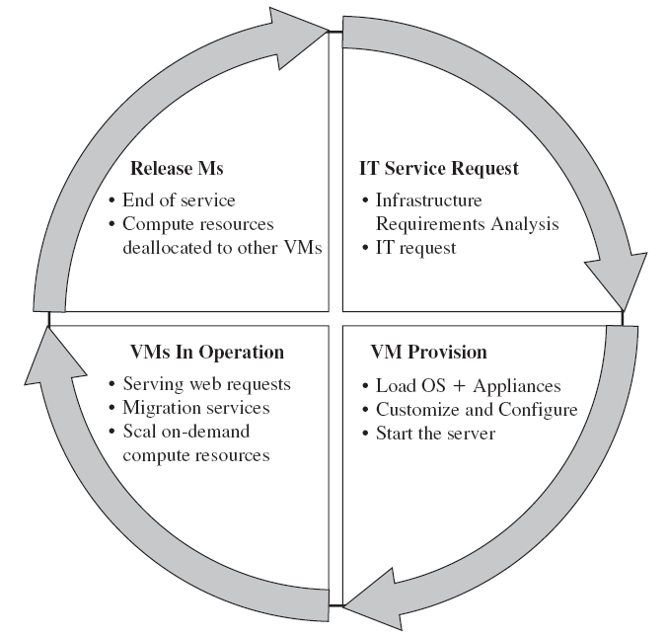
Virtual Machine Life Cycle

Slide 7
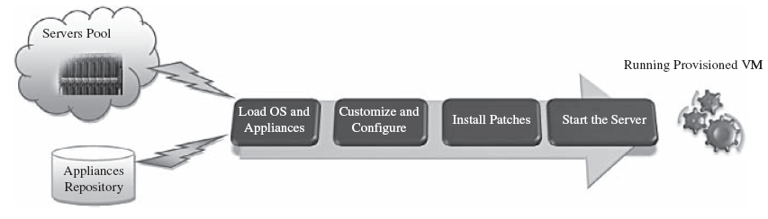
VM Provision Process
Notes:
To summarize, server provisioning is defining server’s configuration based on the organization requirements, a hardware, and software component.
Provisioning from a template is an invaluable feature, because it reduces the time required to create a new virtual machine. This enables the administrator to quickly provision a correctly configured virtual server on demand.
This ease and flexibility bring with them the problem of virtual machine’s sprawl, where virtual machines are provisioned so rapidly that documenting and managing the virtual machine’s life cycle become a challenge.

Slide 8
Migration

Slide 9
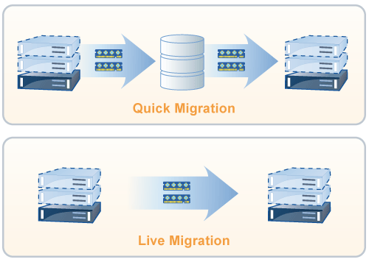
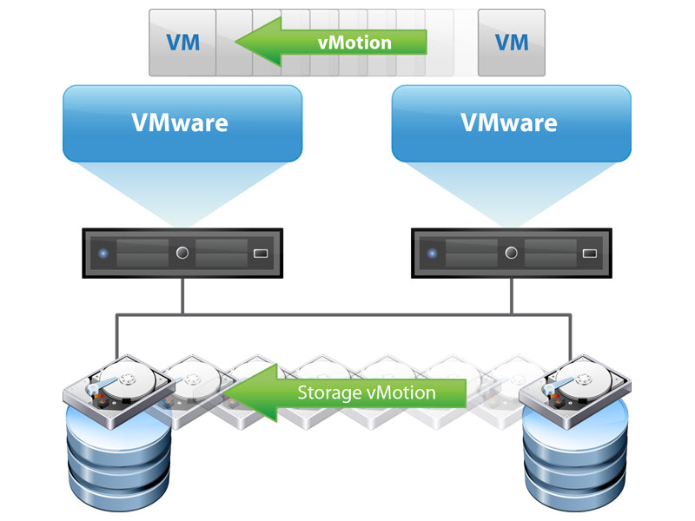
Migration
Notes:
Migration service, in the context of virtual machines, is the process of moving a virtual machine from one host server or storage location to another;
there are different techniques of VM migration, hot/life migration, cold/regular migration, and live storage migration of a virtual machine
In this process, all key machines’ components, such as CPU, storage disks, networking, and memory, are completely virtualized, thereby facilitating the entire state of a virtual machine to be captured by a set of easily moved data files.

Slide 10
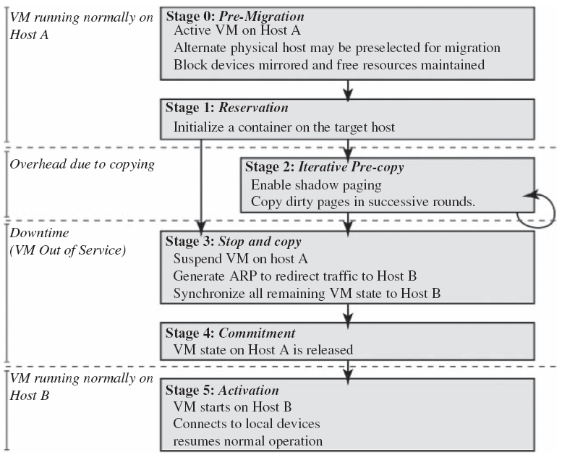
Live Migration
Notes:
Live migration (which is also called hot or real-time migration) can be defined as the movement of a virtual machine from one physical host to another while being powered on.
When it is properly carried out, this process takes place without any noticeable effect from the end user’s point of view (a matter of milliseconds).
advantages of live migration :
facilitates proactive maintenance in case of failure
can be used for load balancing in which work is shared among computers in order to optimize the utilization of available CPU resources
This approach to failure management ensures that at least one host has a consistent VM image at all times during migration.
It depends on the assumption that the original host remains stable until the migration commits and that the VM may be suspended and resumed on that host with no risk of failure.
Citrix XenServer XenMotion
VMware Vmotion

Slide 11
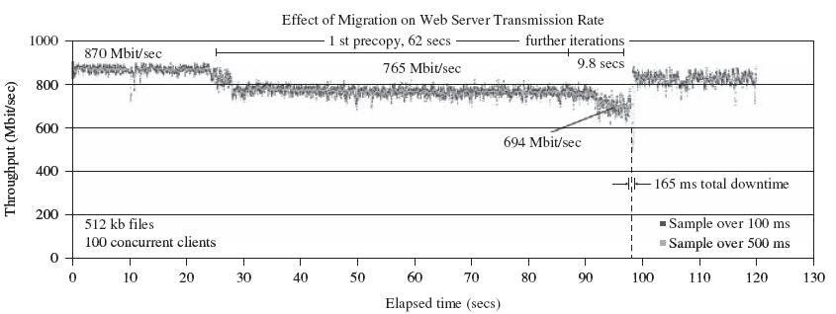
Live migration effect (on a running web server)
Notes:
This simple example demonstrates that a highly loaded server can be migrated with both controlled impact on live services and a short downtime.

Slide 12
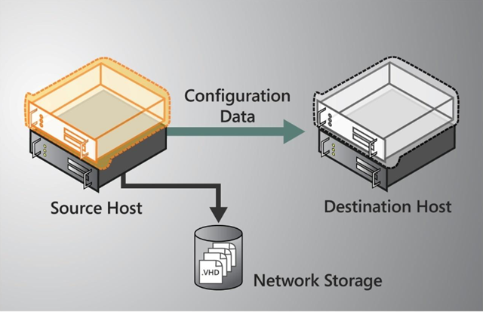
Regular/Cold Migration
Notes:
Cold migration is the migration of a powered-off virtual machine. With cold migration, you have the option of moving the associated disks from one data store to another. The virtual machines are not required to be on a shared storage.
It’s important to highlight that the two main differences between live migration and cold migration are that live migration needs a shared storage for virtual machines in the server’s pool, but cold migration does not; also, in live migration for a virtual machine between two hosts, there would be certain CPU compatibility checks to be applied; while in cold migration this checks do not apply.
cold migration process
The configuration files, including the NVRAM file (BIOS settings), log files, as well as the disks of the virtual machine, are moved from the source host to the destination host’s associated storage area.
The virtual machine is registered with the new host.
After the migration is completed, the old version of the virtual machine is deleted from the source host.

Slide 13
end
Virtual Machine Provisioning and Migration Services

